Slide 1
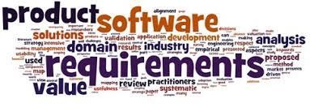
Software Requirement Engineering
Stakeholder, User Classes and The product champion
Week # 3

Slide 2
Stakeholder: A definition
• According to Wiegers & Beatty:
▫ “[A stakeholder is an]individual, group, or organization that is actively involved in a project, is affected by its process or outcome, or can influence its process or outcome.”

Slide 3
1. Identify Your Stakeholders
Start by brainstorming who your stakeholders are. As part of this, think of all the people who are affected by your work, who have influence or power over it, or have an interest in its successful or unsuccessful conclusion.
The table below identifies some of the people who might be stakeholders in your job or in your projects:
Your boss | Shareholders | Government
Senior executives | Alliance partners | Trades associations
Your co-workers | Suppliers | The press
Your team | Lenders | Interest groups
Customers | Analysts | The public
Prospective customers | Future recruits | The community
Your family | Key contributors | Key advisors

Slide 4
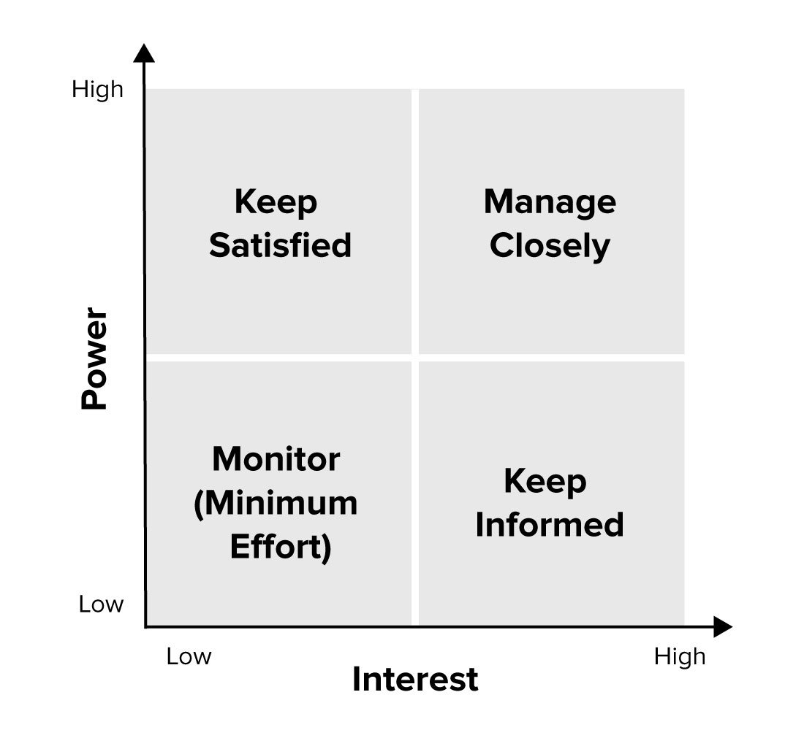
2. Prioritize Your Stakeholders
list people and organizations that are affected by development work. Some of these may have the power either to block that work or to advance it. Some may be interested in what you are doing, while others may not care, so you need to work out who you need to prioritize .
It is need to map out stakeholders, and classify them according to their power over your work and their interest in it, on a Power/Interest Grid (see figure).

Slide 5
2. Prioritize Your Stakeholders
The position that you allocate to a stakeholder on the grid shows you the actions you need to take with them:
High power, highly interested people (Manage Closely): you must fully engage these people, and make the greatest efforts to satisfy them.
High power, less interested people (Keep Satisfied): put enough work in with these people to keep them satisfied, but not so much that they become bored with your message.
Low power, highly interested people (Keep Informed): adequately inform these people, and talk to them to ensure that no major issues are arising. People in this category can often be very helpful with the detail of your project.
Low power, less interested people (Monitor): again, monitor these people, but don’t bore them with excessive communication.
Your boss, for example, likely has high power and influence over your projects and high interest in them. Your family, however, may have high interest in them, but won’t have power over them.

Slide 6
3. Understand Your Key Stakeholders
You now need to discover how your key stakeholders feel about your project. You also need to work out how best to engage them, and how to communicate with them.
Questions that can help you understand your stakeholders include:
What financial or emotional interest do they have in the outcome of your work? Is it positive or negative?
What motivates them most of all?
What information do they want from you, and what is the best way of communicating with them?
What is their current opinion of your work? Is it based on good information?
Who influences their opinions generally, and who influences their opinion of you? Do some of these influencers therefore become important stakeholders in their own right?

Slide 7
3. Understand Your Key Stakeholders
If they aren’t likely to be positive, what will win them around to support your project?
If you don't think that you’ll be able to win them around, how will you manage their opposition?
Who else might be influenced by their opinions? Do these people become stakeholders in their own right?
You can ask your stakeholders these questions directly. People are often quite open about their views, and asking for their opinions is often the first step in building a successful relationship with them.

Slide 8


Slide 9
User Classes
To find the voice of the user, take the following steps:
Identify the different classes of users for your product.
Select and work with individuals who represent each user class and other stakeholder groups.
Agree on who the requirements decision makers are for your project.
Rather than thinking of “the user” in singular, spend some time identifying the multiple user classes and their roles and privileges for your product.

Slide 10
Differentiating user classes
• Access privilege or security level (admin/guest/...)
• Tasks performed (during business operations)
• Features used
• Frequency of product use
• Experience, expertise (application domain, computer systems)
• Platforms and devices used (desktop/laptop PC, tablet, smartphone, etc.)
• Native language
• Interaction with the system (direct/indirect)

Slide 11
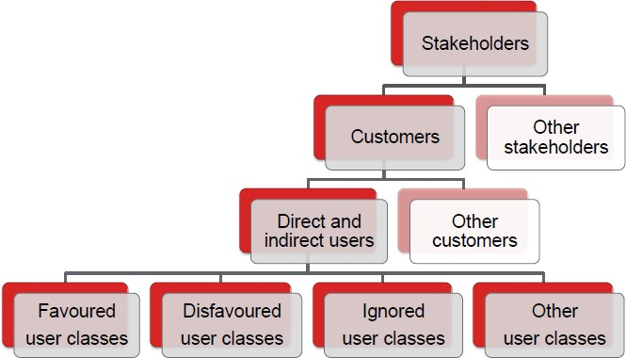
A possible hierarchy

Slide 12
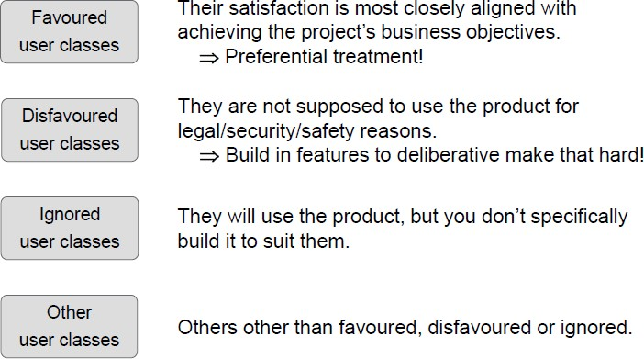
User classes

Slide 13
Identifying your user classes
Various analysis models can help you identify user classes.
The external entities shown outside your system on a context diagram are candidates for user classes. A corporate organization chart can also help you discover potential users and other stakeholders (Beatty and Chen 2012).
Figure 2 illustrates a portion of the organization chart for Contoso Pharmaceuticals. Nearly all of the potential users for the system are likely to be found somewhere in this chart.

Slide 14
Identifying your user classes
While performing stakeholder and user analysis, study the organization
chart to look for:
Departments that participate in the business process.
Departments that are affected by the business process.
Departments or role names in which either direct or indirect users might be found.
User classes that span multiple departments.
Departments that might have an interface to external stakeholders outside the company.

Slide 15
Identifying your user classes
Organization chart analysis reduces the likelihood that you will overlook an important class ofusers within that organization.
It shows you where to seek potential representatives for specific user classes, as well as helping determine who the key requirements decision makers might be.
You might find multiple user classes with diverse needs within a single department. Conversely, recognizing the same user class in multiple departments can simplify requirements elicitation.
Studying the organization chart helps you judge how many user representatives you’ll need to work with to feel confident that you thoroughly understand the broad user community’s needs.
Also try to understand what type of information the users from each department might supply based on their role in the organization and their department’s perspective on the project.

Slide 17
User personas

Slide 18
Connecting with user representatives

Slide 19
The product champion
Each of our projects included a few key members of our user community to provide the requirements. We called these people product champions (Wiegers 1996).
The product champion approach provides an effective way to structure all-important customer-development collaborative partnership.
Each product champion serves as the primary interface between members of a single user class and the project’s business analyst.
Ideally, the champions will be actual users, not surrogates such as funding sponsors, marketing staff, user managers, or software developers imagining themselves to be users.
Product champions gather requirements from other members of the user classes they represent and reconcile inconsistencies.

Slide 20
The product champion
The best product champions have a clear vision of the new system.
They’re enthusiastic because they see how it will benefit them and their peers.
Champions should be effective communicators who are respected by their colleagues. They need a thorough understanding of the application domain and the solution’s operating environment.
External product champions

Slide 21
Product champion expectations

Slide 22
Product champion expectations

Slide 23
Multiple product champions

Slide 24
The voiceless user class

Slide 25
Product champion traps to avoid
Watch out for the following potential problems:
Managers override the decisions that a qualified and duly authorized product champion makes. Perhaps a manager has a wild new idea at the last minute, or thinks he knows what the users need. This behavior often results in dissatisfied users and frustrated product champions who feel that management doesn’t trust them.
A product champion who forgets that he is representing other customers and presents only his own requirements won’t do a good job. He might be happy with the outcome, but others likely won’t be.

Slide 26
Product champion traps to avoid
A product champion who lacks a clear vision of the new system might defer decisions to the BA. If all of the BA’s ideas are fine with the champion, the champion isn’t providing much help.
A senior user might nominate a less experienced user as champion because she doesn’t have time to do the job herself. This can lead to backseat driving from the senior user who still wishes to strongly influence the project’s direction.

Slide 27
User representation on agile projects
Some agile development methods include a single representative of stakeholders called a product owner in the team to serve as the voice of the customer (Schwaber 2004; Cohn 2010; Leffingwell 2011).
The product owner defines the product’s vision and is responsible for developing and prioritizing the contents of the product backlog. (The backlog is the prioritized list of user stories—requirements—for the product and their allocation to upcoming iterations, called sprints in the agile development method called Scrum.)
The product owner therefore spans all three levels of requirements: business, user, and functional.
He essentially straddles the product champion and business analyst functions, representing the customer, defining product features, prioritizing them, and so forth. Ultimately, someone does have to make decisions about exactly what capabilities to deliver in the product and when. In Scrum, that’s the product owner’s responsibility.

Slide 28
Resolving conflicting requirements

